Slide 1
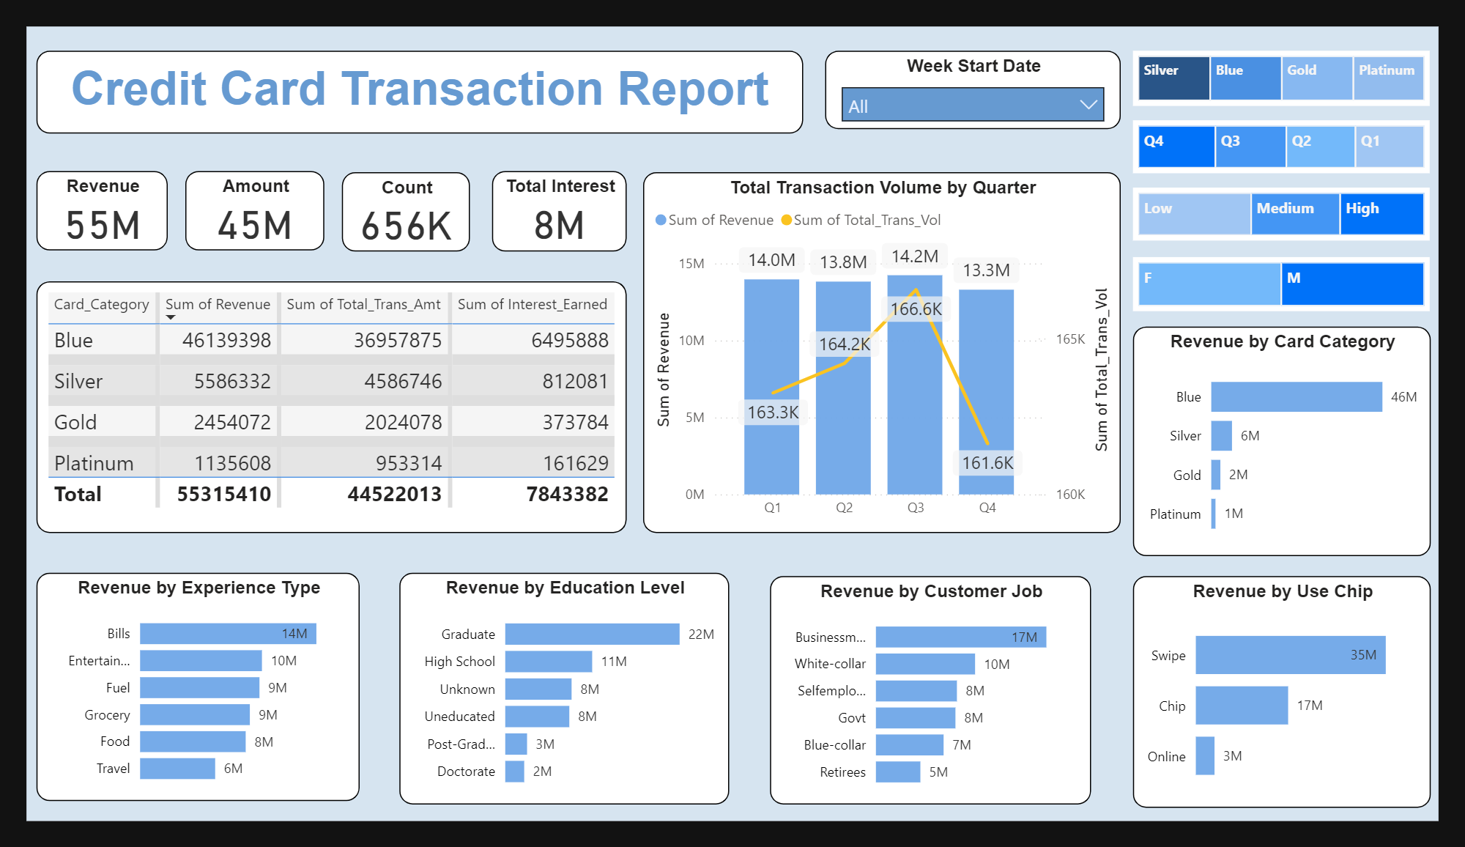
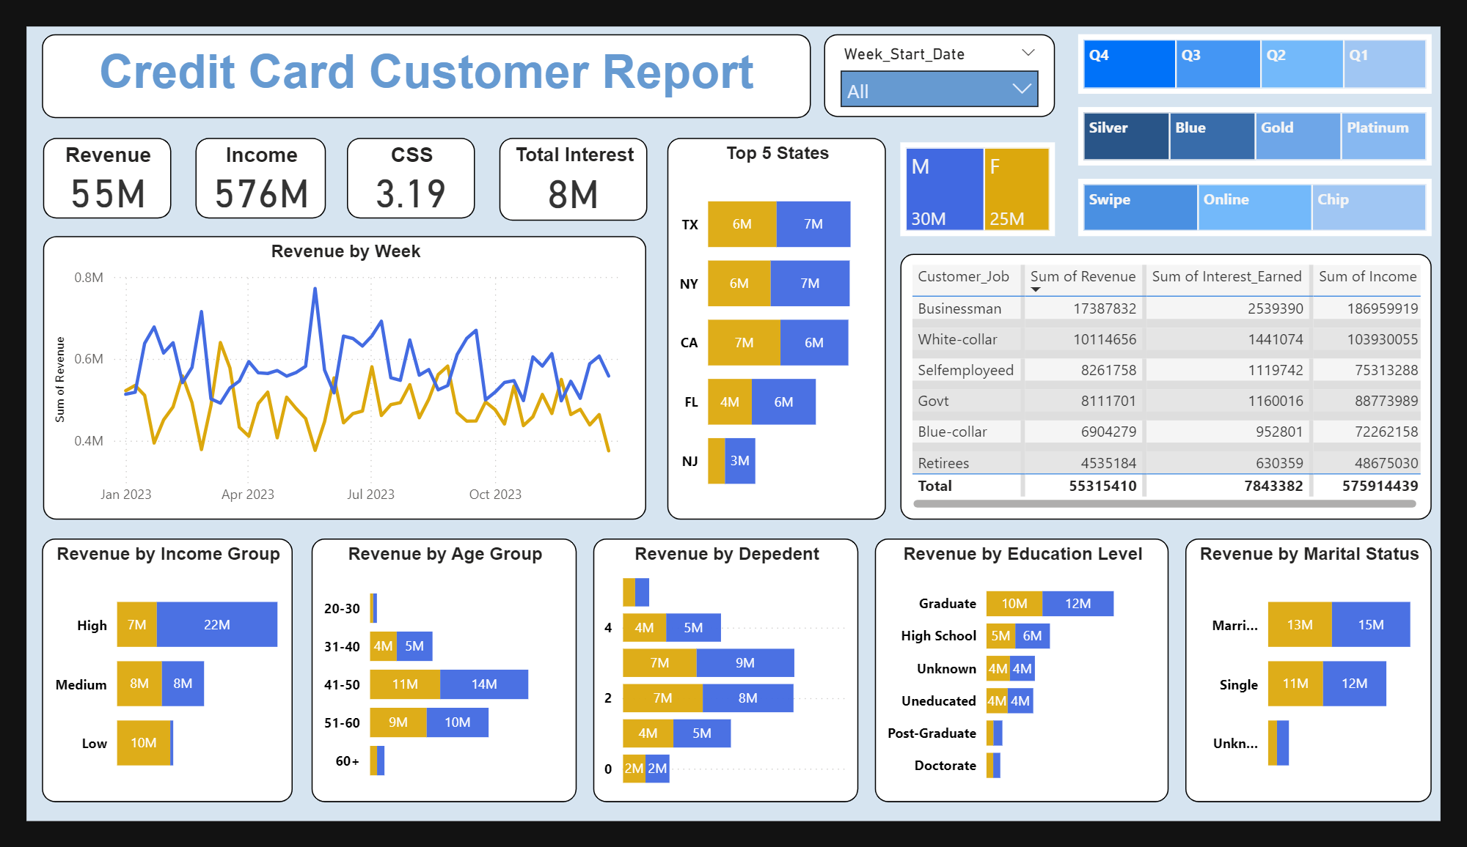
Credit Card Performance Analysis
Issues/Problem
The project addresses the need to analyze credit card transaction trends and customer demographics to optimize financial strategies and enhance customer targeting.
Response
Over 55 million in revenue across 4 quarters.
Segmentation of 576 million total customer income.
Transaction trends across 50,000+ credit card users.
Impact
Identified Blue card users as the highest revenue contributors (46 million).
Quantified regional trends, highlighting NY, TX, CA, FL, and NJ contributing a total of 31 million revenue.
Provided clear visualizations to inform targeted marketing and service enhancement efforts.
Recommendation
Card Category Analysis: Blue card users drive 83% of revenue; promotional efforts should prioritize retaining and upselling this segment.
Income Group Trends: High-income customers generate over 40% of total revenue. Implement premium-tier benefits for loyalty.
Transaction Mode Preferences: Chip-based transactions contribute 63% of revenue (35 million); promoting these channels could optimize transaction reliability.
Demographics Insight: Customers aged 31-40 and 51-60 spend the most (~25 million collectively); campaigns targeting these age groups can maximize engagement.
Geographical Advantage: Focus on expanding services and promotions in NY, TX, and CA, which together contributed over 19 million in revenue.

